Slide 1


Slide 2
Virtual Memory

Slide 3
Content
Background
Demand Paging
Page Replacement
Allocation of Frames
Thrashing
Page Size and Other Considerations
Demand Segmentation

Slide 4
Introduction
1
Let’s start with the first set of slides

Slide 5
Objectives
To describe the benefits of a virtual memory system
To explain the concepts of demand paging, page-replacement algorithms, and allocation of page frames
To discuss the principle of the working-set model

Slide 6
Preceding sections we discussed about how to avoid memory fragmentation by breaking process memory requirements down into smaller bites ( pages ), and storing the pages non-contiguously in memory.
However the entire process still had to be stored in memory somewhere.

Slide 7
In practice, most real processes do not need all their pages, or at least not all at once, for several reasons:
Error handling code is not needed unless that specific error occurs, some of which are quite rare.
Arrays are often over-sized for worst-case scenarios, and only a small fraction of the arrays are actually used in practice.
Certain features of certain programs are rarely used, such as the routine to balance the federal budget. :-)

Slide 8
The ability to load only the portions of processes that were actually needed ( and only when they were needed ) has several benefits:
Programs could be written for a much larger address space ( virtual memory space ) than physically exists on the computer.
Because each process is only using a fraction of their total address space, there is more memory left for other programs, improving CPU utilization and system throughput.
Less I/O is needed for swapping processes in and out of RAM, speeding things up.

Slide 9
Background
Virtual memory – involves separation of user logical memory from physical memory
This leads Logical address space can therefore be much larger than physical address space
Only part of the program needs to be in memory for execution
Allows address spaces to be shared by several processes
Allows for more efficient process creation
More programs running concurrently
Less I/O needed to load or swap processes

Slide 10
Background…
Virtual memory can be implemented via:
Demand paging
Demand segmentation

Slide 11
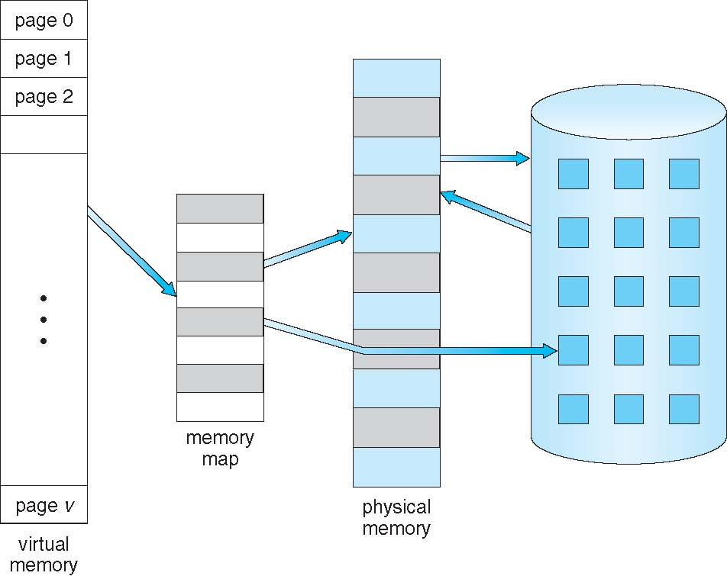
Virtual Memory That is Larger Than Physical Memory

Slide 12
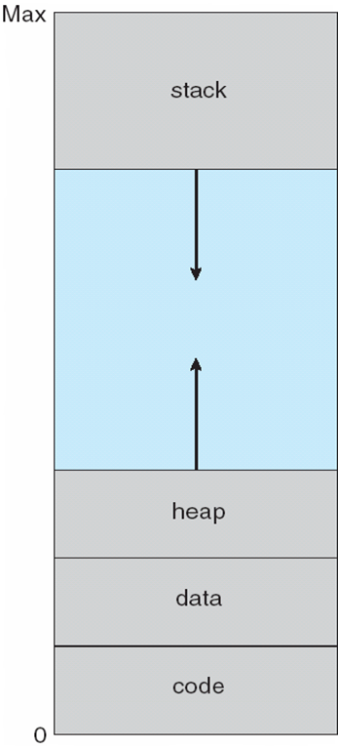
Virtual-address Space
Figure shows virtual address space, which is the programmers logical view of process memory storage. The actual physical layout is controlled by the process's page table.
Note that the address space shown in Figure is sparse - A great hole in the middle of the address space is never used, unless the stack and/or the heap grow to fill the hole.

Slide 13
Virtual memory also allows the sharing of files and memory by multiple processes, with several benefits:
System libraries can be shared by mapping them into the virtual address space of more than one process.
Processes can also share virtual memory by mapping the same block of memory to more than one process.
Process pages can be shared during a fork( ) system call, eliminating the need to copy all of the pages of the original ( parent ) process.

Slide 14
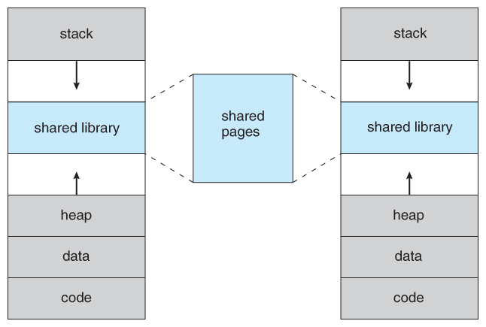
Shared library using virtual memory

Slide 15
Demand Paging
How an executable program might be loaded from disk into memory
One option to execute a program is to load the entire program in to physical memory at execution time.
problem with this approach is that we may not initially need the entire program in memory
An alternative strategy is to initially load pages only as they are needed. This technique is known as demand paging and is commonly used in virtual memory.
Pages are loaded only when they are demanded during program execution

Slide 16
Pages that are never accessed are not loaded into physical memory which lead to
Less I/O needed, no unnecessary I/O
Less memory needed
Faster response
More users

Slide 17
A demand paging system is similar to a paging scheme with swapping. Rather than swapping the entire process in to memory, we use Lazy Swappers-the job of this is to swap only that page which is needed into the memory, rather than swapping the entire process in to the memory.
Instead of swapping in a whole process, the pager brings only those necessary pages into memory
Thus it avoids reading in to memory pages that will not be used any way, decreasing the swap time and the a mount of physical memory needed

Slide 18
Page is needed → reference to it
invalid reference → abort
not-in-memory → bring to memory
Lazy swapper – never swaps a page into memory unless page will be needed
Swapper that deals with pages is a pager

Slide 19
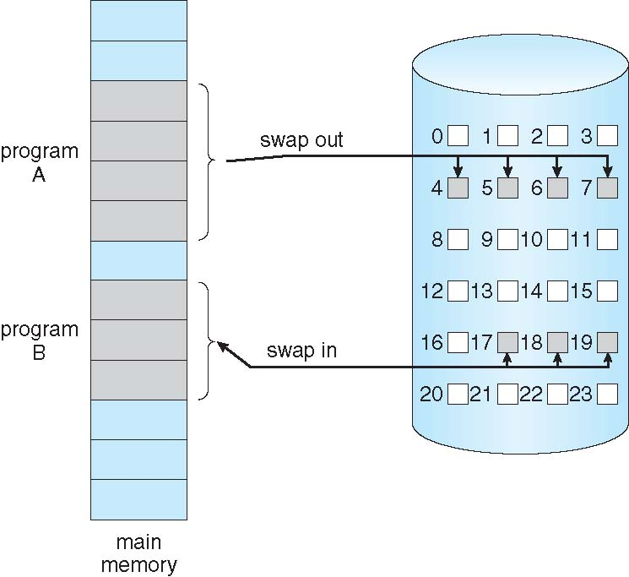
Transfer of a Paged Memory to Contiguous Disk Space

Slide 20
When a process is to be swapped in, the pager guesses which pages will be used before the process is swapped out again.
Instead of swapping in a whole process, the pager brings only those pages into memory.
With this scheme, we need some form of hardware support to distinguish between the pages that are in memory and the pages that are on the disk.

Slide 21
The valid -invalid bit scheme can be used for this purpose.
This time, when this bit is set to "valid' the associated page is both legal and in memory. If the bit is set to "invalid/' the page either is not valid (that is, not in the logical address space of the process) or is valid but is currently on the disk

Slide 22
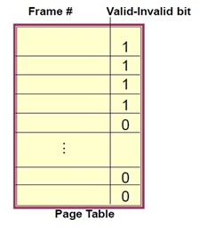
Valid Invalid bit
With each page table entry a valid–invalid bit is associated (1 in-memory, 0 not-in-memory)
Initially valid–invalid bit is set to 0 on all entries
If the bit is set to ―invalid‖, the page is either not in the logical address space of the process or is valid but is currently on the disk

Slide 23
The page table entry for a page that is brought into memory set as usual, but the page-table entry for a page that is not currently in memory is either marked invalid or contains the address of the page on the disk
Marking a page invalid has no effect if the process never attempts to access a page.
A page fault occurs when the process tries to access a page that was not brought into memory

Slide 24
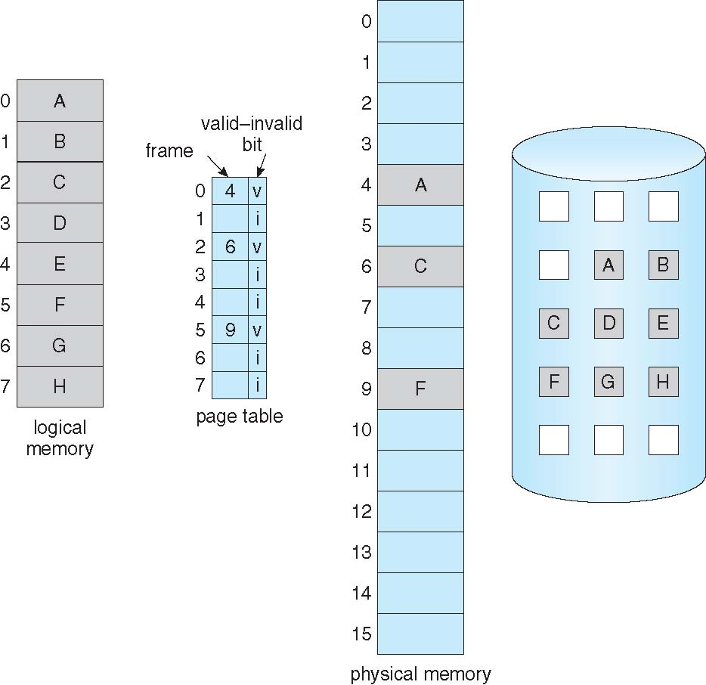
Page Table When Some Pages Are Not in Main Memory
NOTE: The valid-invalid bit scheme described can be used for this purpose. Marking a page invalid will have no effect if the process never attempts to access that page.

Slide 25
Page-fault
While the process executes and accesses pages that are memory resident, execution proceeds normally. Thus when a program tries to access a page, which was not brought in to the memory page fault occurs.
Access to a page marked invalid causes a page-fault trap. Translating the address through the page table, will notice that the invalid bit is set, causing a trap to OS. This trap is the result of the operating system's failure to bring the desired page into memory..

Slide 26
The procedure for handling this page fault
check an internal table (usually kept with PCB) for the process to determine whether the reference was a valid or an invalid memory access.
If the reference was invalid, we terminate the process. If it was valid, but we have not yet brought in that page, we now page it in.
We find a free frame (by taking one from the free-frame list)

Slide 27
4. We schedule a disk operation to read the desired page into the newly allocated frame.
5. When the disk read is complete, we modify the internal table kept with the process and the page table to indicate that the page is now in memory.
6. Restart the instruction that was interrupted by the trap. The process can now access the page as though it had always been in memory

Slide 28
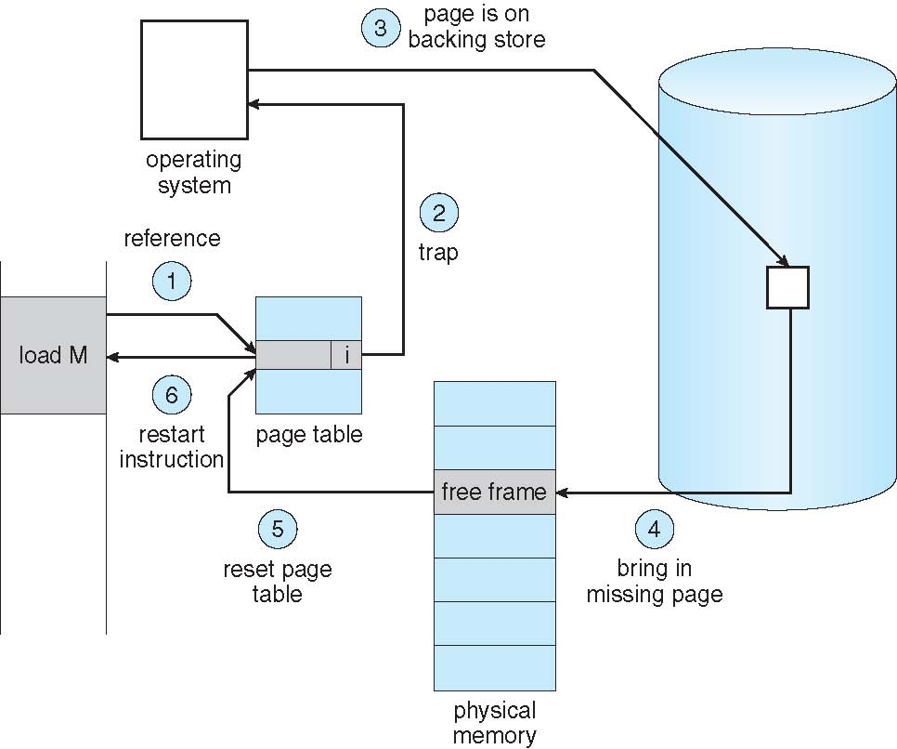
Steps in Handling a Page Fault

Slide 29
PURE DEMAND PAGING.
We can start executing a process with no pages in memory. When the OS sets the instruction pointer to the first instruction of the process, the process will immediately fault for the page.
After this page is brought in to memory, the process continues to execute, faulting as and when necessary until every needed page was actually in memory. This is pure demand paging.

Slide 30
The hardware to support demand paging is same as the hardware for paging and swapping.
Page table : This table has the ability to mark an entry invalid through a valid-invalid bit or special value of protection bits.
Secondary memory :They are usually a high speed disk or drums used to hold those pages that are not in memory. Backing store is also called as swap place

Slide 31
Performance of Demand Paging (Cont.)
Demand paging has a significant effect on the performance of a computer system, i.e., the Effective Access Time
For most computer systems, the memory-access time denoted ma, ranges from 10 to 200 Nano seconds.
When there are no page faults, the effective access time is equal to memory access time.

Slide 32
If a page fault occurs, the relevant page must be read from the disk first and then access the desired word
Page Fault Rate 0 ≤ p ≤ 1
if p = 0 no page faults
if p = 1, every reference is a fault
Effective Access Time (EAT)
EAT = (1 – p) x memory access + p (page fault overhead + swap page out
+ swap page in + restart overhead )

Slide 33
Demand Paging Example
Memory access time = 200 nanoseconds
Average page-fault service time = 8 milliseconds
EAT = (1 – p) x 200 + p (8 milliseconds)
= (1 – p x 200 + p x 8,000,000
= 200 + p x 7,999,800
If one access out of 1,000 causes a page fault, then
EAT = 8.2 microseconds.
This is a slowdown by a factor of 40!!

Slide 34
If want performance degradation < 10 percent
220 > 200 + 7,999,800 x p 20 > 7,999,800 x p
p < .0000025
< one page fault in every 400,000 memory accesses

Slide 35
Page Replacement
we assumed that each page faults at most once, when it is first referenced. This representation is not strictly accurate.
If a process of 10 pages actually uses only half of them, then demand paging saves the I/0 necessary to load the 5 pages that are never used.
We could also increase our degree of multiprogramming by running twice as many processes. Thus, if we had 40 frames, we could run 8 processes, rather than the 4 that could run if each required 10 frames (five of which were never used).

Slide 36
If we increase our degree of multiprogramming, we are over-allocating memory. If we run 6 processes, each of which is 10 pages in size but uses only 5 pages, we have higher CPU utilization and throughput, with10 frames to spare.
It is possible, that each of these processes, for a particular data set, may suddenly try to use all ten of its pages, resulting in a need for sixty frames when only forty are available

Slide 37
Over-allocation of memory manifests itself as follows. While a user process is executing, a page fault occurs.
The operating system determines where the desired page is residing on the disk but then finds that there are no free frames on the free-frame list; all memory is in use (Figure)

Slide 38
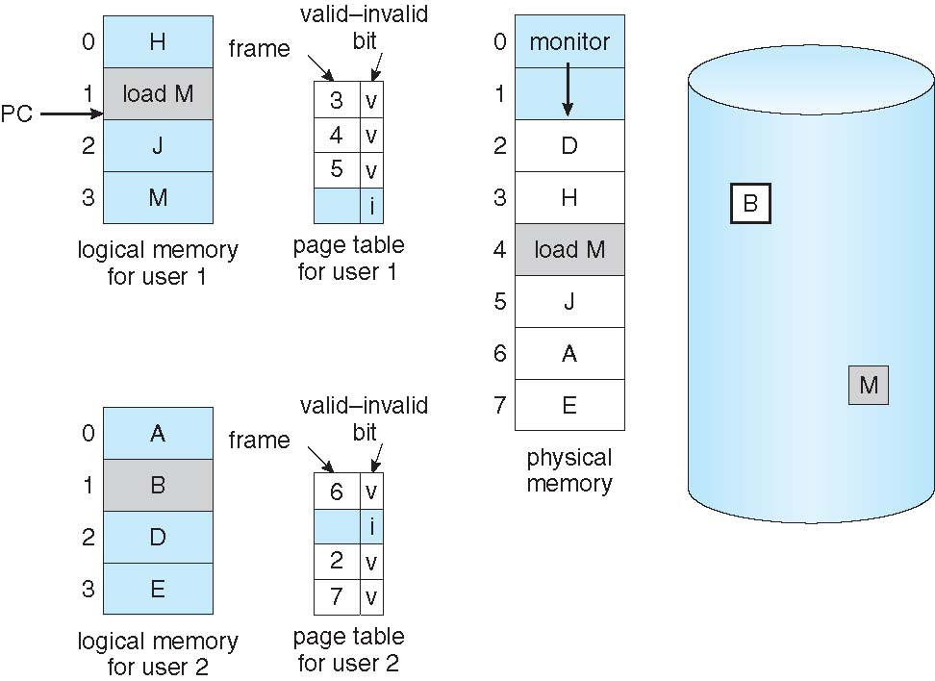

Slide 39
The o s has several options
It could terminate the user process. However this is not desirable since the Users should not be aware that their processes are running on a paged system-paging should be logically transparent to the user. So this option is not the best choice
Other option is the operating system could instead swap out a process, freeing all its frames and reducing the level of multiprogramming. This option is a good one
the most common solution is Page Replacement

Slide 40
Basic Page Replacement
Page replacement takes the following approach. If no frame is free, we find one that is not currently being used and free it. We can free a frame by writing its contents to swap space, and changing the page table.

Slide 41
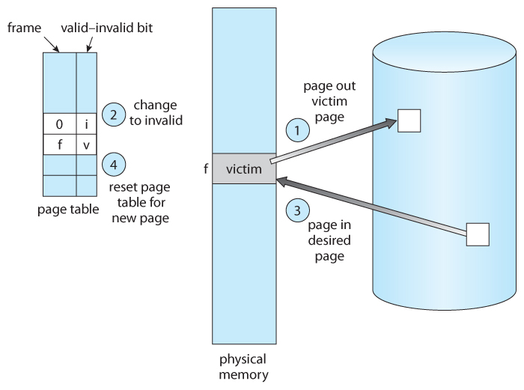

Slide 42
Find the location of the desired page on disk.
Find a free frame:
If there is a free frame, use it.
Otherwise, use a page replacement
algorithm to select a victim frame.
Write the victim page to the disk; change the page and frame tables accordingly.
Read the desired page into the (newly) free frame. Update the page and frame tables.
Restart the user process.

Slide 43
If no frames are free, two page transfers (one out and one in) are required. This doubles the page-fault service time and increases the effective access time
This overhead can be reduced by using a modify bit (or dirty bit). This bit is set by hardware when ever any word or byte in the memory is modified
When we select a pager for replacement, we examine its modify bit. If the bit is set, we know that the page has been modified since it was read in from the disk. In this case, we must write that page to the disk

Slide 44
If the modify bit is not set, the page has not been modified since it was read in to memory. Hence we need not write the memory page to the disk as it is already there
This technique also applies to read-only pages. Such pages can not be modified; thus they may be discarded when desired

Slide 45
Page-replacement algorithms
There are two major requirements to implement a successful demand paging system. We must develop a frame-allocation algorithm and a page-replacement algorithm.
The former centers around how many frames are allocated to each process ( and to other needs ), and the latter deals with how to select a page for replacement when there are no free frames available.
Every OS has its own unique replacement scheme and there are many page replacement algorithms. Any algorithm should aim at lowest page-fault rate.

Slide 46
Every algorithm is evaluated by running it on a particular string of memory references (reference string) and computing the number of page faults on that string. In all our examples, the reference string is
1, 2, 3, 4, 1, 2, 5, 1, 2, 3, 4, 5
The following are the different page replacement algorithms.
FIFO algorithms
Optimal replacement algorithm
Least Recently Used (LRU) algorithm
LRU approximation
Adhoc algorithm

Slide 47
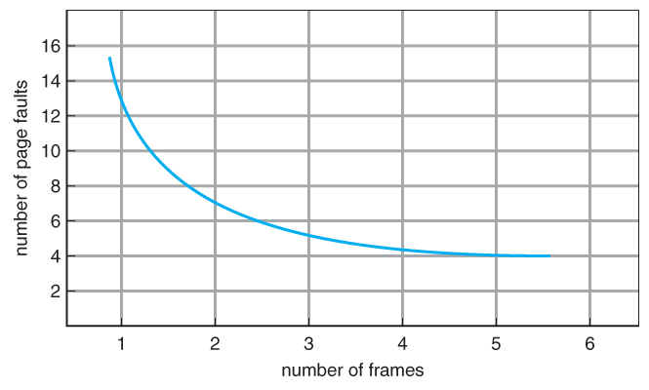
Graph of page faults versus number of frames.
As the number of frames available increases, the number of page faults decreases. As the number of frames increases, the number of page faults drops to some minimal level

Slide 48
FIFO Page Replacement
Simplest replacement algorithm
Time at which a page is brought into memory is recorded with each page
The oldest page is chosen for replacement
A FIFO queue is created to hold all pages in memory. The page at the head of the queue is replaced and a new page is inserted at the tail of the queue
It is easy to understand and program, but performance is not always good

Slide 49
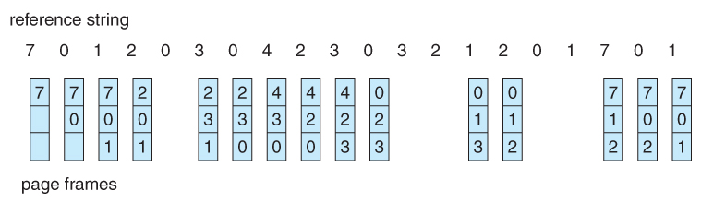
FIFO Page Replacement
The first 3 references (7,0,1) cause page faults and are brought into these empty frames.
The next reference (2) replaces page 7,
The first reference to 3 replaces page 0. Due to this replacement, the next reference to 0 will result in page fault. Page 1 is then replaced by page 0. This process continues and results in 15 page faults

Slide 50
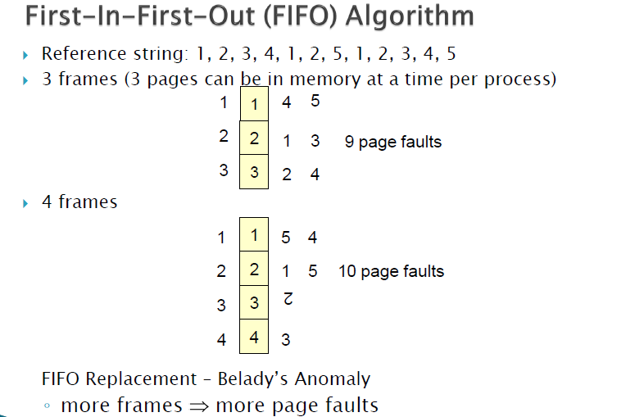

Slide 51
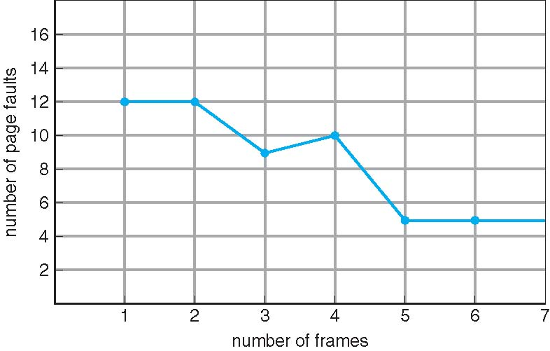
FIFO Illustrating Belady’s Anomaly

Slide 52
Optimal Page Replacement
Optimal page replacement algorithm is mainly to solve the problem of Belady’s Anomaly.
Optimal page replacement algorithm has the lowest page fault rate of all algorithms.
An optimal page replacement algorithm exists and has been called OPT.
The working is simple “Replace the page that will not be used for the longest period of time” Example:
consider the following reference string
Used for measuring how well your algorithm performs

Slide 53
Optimal Page Replacement
The concept behind this algorithm is that
―replace the page that will not be used for the longest period of time‖
This is twice as good a FIFO.
It is difficult to implement because it requires future knowledge of the reference string

Slide 54
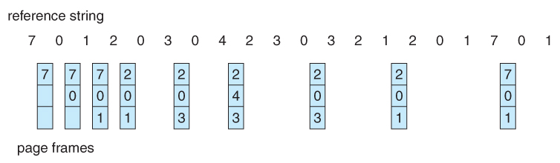
The first three references cause faults that fill three empty frames
Reference to page 2 replaces page 7 because 7 will not be used until reference 18, whereas page 0 will be used at 5, and page 1 at 14. The reference to page 3 replaces page1 as page 1 will be the last of the three pages in memory to be referenced again
This algorithm results in 9 page faults

Slide 55
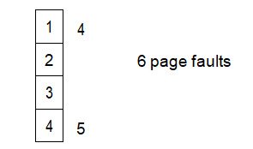
Optimal Algorithm
Replace page that will not be used for longest period of time
4 frames example
1, 2, 3, 4, 1, 2, 5, 1, 2, 3, 4, 5
How do you know this?
Used for measuring how well your algorithm performs

Slide 56
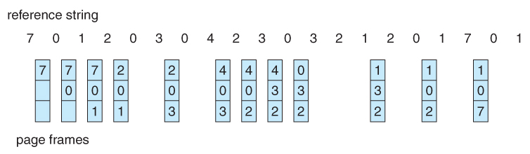
LRU Page Replacement
Use past knowledge rather than future
Replace page that has not been used in the most amount of time
Associate time of last use with each page
12 faults – better than FIFO but worse than OPT
Generally good algorithm and frequently used
But how to implement?

Slide 57
Allocation of Frames
How do we allocate the fixed amount of free memory among the various processes? If we have 93 free frames and two processes, how many frames does each process get?
The simplest case is the single-user system. Consider a single-user system with 128 KB of memory composed of pages 1 KB in size. This system has 128 frames. The operating system may take 35 KB, leaving 93 frames for the user process.

Slide 58
Under pure demand paging, all 93 frames would initially be put on the free-frame list. When a user process started execution, it would generate a sequence of page faults.
The first 93 page faults would all get free frames from the free-frame list. When the free-frame list was exhausted, a page-replacement algorithm would be used to select one of the 93 in memory pages to be replaced with the 94th, and so on.
When the process terminated, the 93 frames would once again be placed on the free-frame list.

Slide 59
Allocation of frames are constrained in various ways
We cannot, allocate more than the total number of available frames (unless there is page sharing). We must also allocate at least a minimum number of frames
One reason for allocating at least a minimum number of frames involves performance. Obviously, as the number of frames allocated to each process decreases, the page-fault rate increases, slowing process execution

Slide 60
In addition, when a page fault occurs before an executing instruction is complete, the instruction must be restarted. Consequently.
we must have enough frames to hold all the different pages that any single instruction can reference

Slide 61
Allocation Algorithms
Equal allocation: The easiest way to split m frames among n processes is to give everyone an equal share, m/n frames.
For instance, if there are 93 frames and five processes, each process will get 18 frames. The three leftover frames can be used as a free-frame buffer pool. This scheme is called Equal allocation

Slide 62
Proportional allocation – Allocate according to the size of process
Dynamic as degree of multiprogramming, process sizes change
Let the size of the virtual memory for process pi be si, and define

Slide 63
Global vs. Local Allocation
One big question is whether frame allocation (page replacement) occurs on a local or global level.
With local replacement, the number of pages allocated to a process is fixed, and page replacement occurs only amongst the pages allocated to this process.
With global replacement, any page may be a potential victim, whether it currently belongs to the process seeking a free frame or not.

Slide 64
Local page replacement allows processes to better control their own page fault rates, and leads to more consistent performance of a given process over different system load levels.
Global page replacement is overall more efficient, and is the more commonly used approach

Slide 65
Global vs. Local Allocation
Global replacement – process selects a replacement frame from the set of all frames; one process can take a frame from another
But then process execution time can vary greatly
But greater throughput so more common
Local replacement – each process selects from only its own set of allocated frames
More consistent per-process performance
But possibly underutilized memory

Slide 66
Thrashing
Consider any process that does not have "enough" frames. If the process does not have the number of frames it needs to support pages in active use, it will quickly page-fault. At this point, it must replace some page.
However, since all its pages are in active use, it must replace a page that will be needed again right away. Consequently, it quickly faults again, and again, and again, replacing pages that it must bring back in immediately
This high paging activity is called thrashing. A process is thrashing if it is spending more time paging than executing

Slide 67
Cause of Thrashing
Thrashing results in severe performance problems. Consider the following scenario, which is based on the actual behaviour of early paging systems
The operating system monitors CPU utilization. If CPU utilization is too low, we increase the degree of multiprogramming by introducing a new process to the system.
A global page-replacement algorithm is used; it replaces pages without regard to the process to which they belong. Now suppose that a process enters a new phase in its execution and needs more frames.

Slide 68
It starts faulting and taking frames away from other processes. These processes need those pages and so they also fault, taking frames from other processes. These faulting processes must use the paging device to swap pages in and out. As they queue up for the paging device, the ready queue empties. As processes wait for the paging device, CPU utilization decreases.
The CPU scheduler sees the decreasing CPU utilization and increases the degree of multiprogramming as a result.
The new process tries to get started by taking frames from running processes, causing more page faults and a longer queue for the paging device. As a result, CPU utilization drops even further, and the CPU scheduler tries to increase the degree of multiprogramming even more.

Slide 69
Thrashing has occurred, and system throughput plunges. The page fault rate increases tremendously.
As a result, the effective memory-access time increases. No work is getting done, because the processes are spending all their time paging.
This phenomenon is illustrated in Figure. in which CPU utilization is plotted against the degree of multiprogramming.

Slide 70
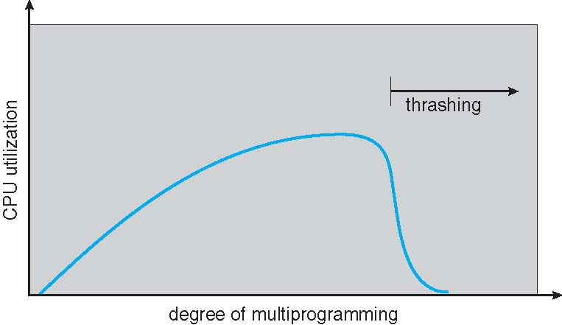
As the degree of multiprogramming increases, CPU utilization also increases, although more slowly, until a maximum is reached. If the degree of multiprogramming is increased even further, thrashing sets in, and CPU utilization drops sharply. At this point, to increase CPU utilization and stop thrashing, we must decrease the degree of multiprogramming.

Slide 71
We can limit the effects of thrashing by using local replacement algorithm. With local replacement, if one process starts thrashing, it cannot steal frames from another process and cause the latter to thrash as well.
However, the problem is not entirely solved. If processes are thrashing, they will be in the queue for the paging device most of the time. The average service time for a page fault will increase because of the longer average queue for the paging device. Thus, the effective access time will increase even for a process that is not thrashing.

Slide 72
Summary
Thrashing is a high paging activity. A process is thrashing if it is spending more time with paging rather than execution. Caused by:- * global replacement algorithm. * under allocation of the minimum number of pages required by a process. * very high degree of multiprogramming. Eliminated by:- *reducing level or degree of multiprogramming. *use local replacement algorithm. *while allocating check minimum sufficient frame required for a process.

